Slide 1
Deploying a Two-Tier Web Architecture on AWS
Subtitle- Using EC2, RDS, VPC, and Joomla Database
Prepared by- Akshy Kumar Sahu
Date: 01 January 2026

Slide 2
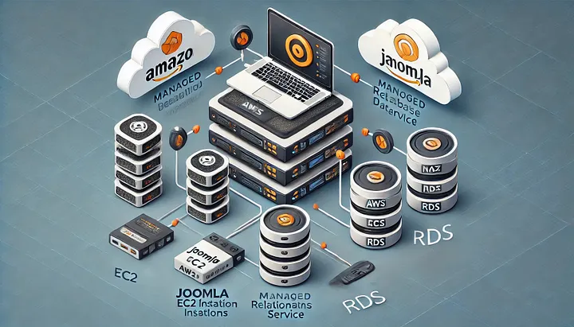
Introduction
Cloud Computing enables scalable and reliable web application
A two tire architecture separates:
- Application layer
- Database layer
This project focuses on deploying a joomla-based web application using aws services

Slide 3
AWS Services Involved/ High-Level Architecture
Amazon vpc- Custom network isolation & segmentation
Subnet (Public & Private): Enhanced security and traffic control
Amazon EC2 (Amazon Linux): Hosting Joomla CMS application
Amazon RDS (MySQL): Managed and secure database service
Internet Gateway & Route Tables: Enables internet access for public resources
Application Load Balancer (ALB): Efficient traffic distribution across instances

Slide 4
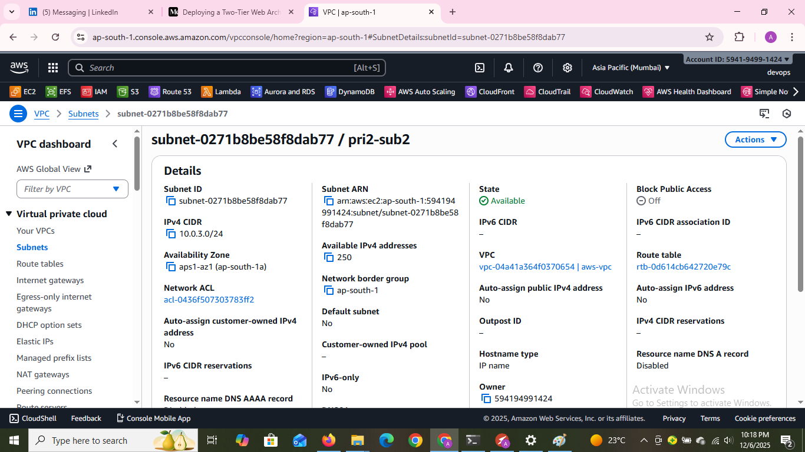
Two-Tier Architecture Overview

Slide 5
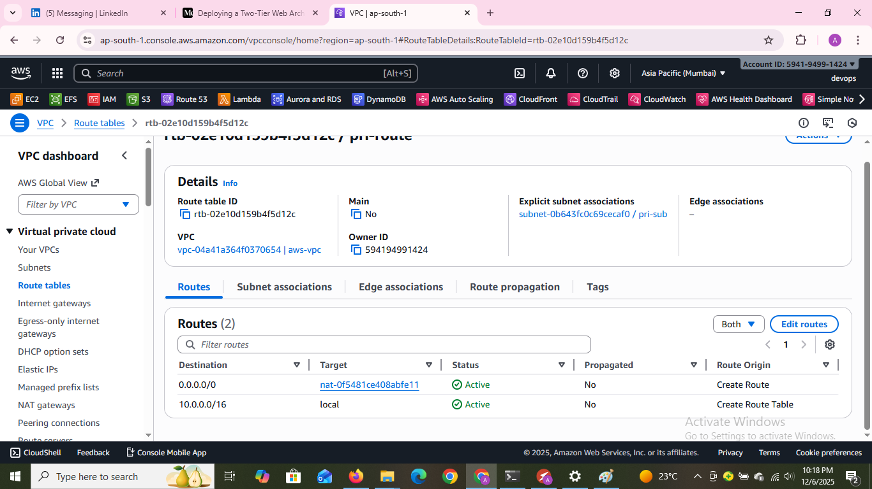

Slide 6
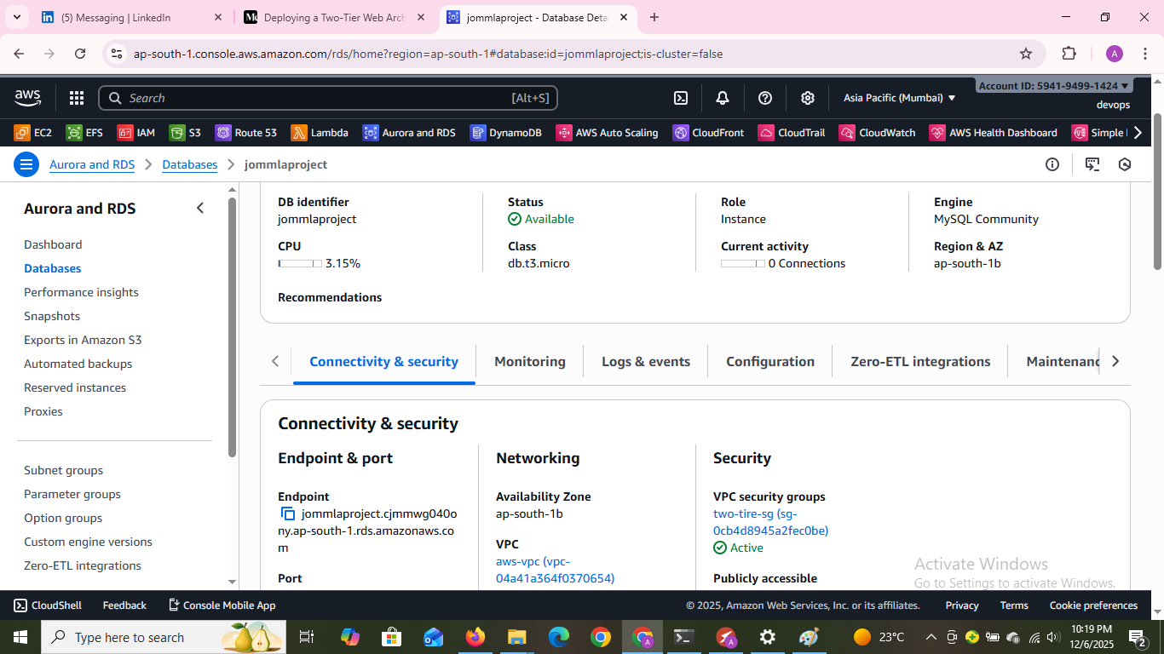

Slide 7
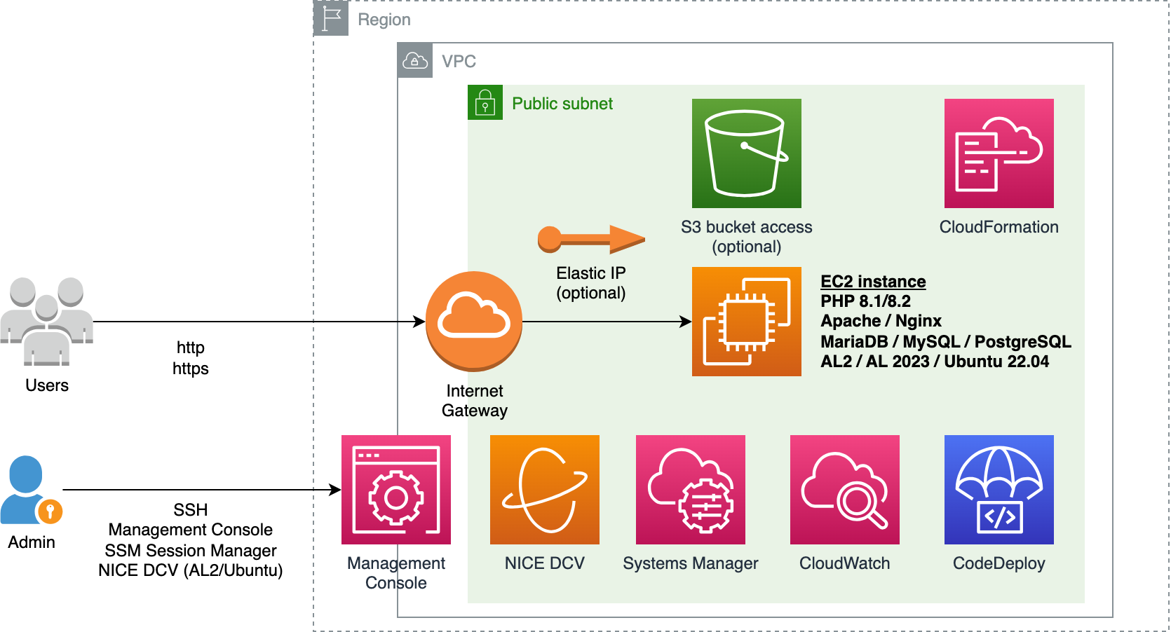
Application Tier – EC2 Setup
Deploy EC2 instances to host the application/business logic layer.
Ensure connectivity with the web/presentation tier and database tier.
Configure security groups and firewall rules for safe communication.
Implement auto-scaling and load balancing for scalability.
Monitor performance using CloudWatch.

Slide 8
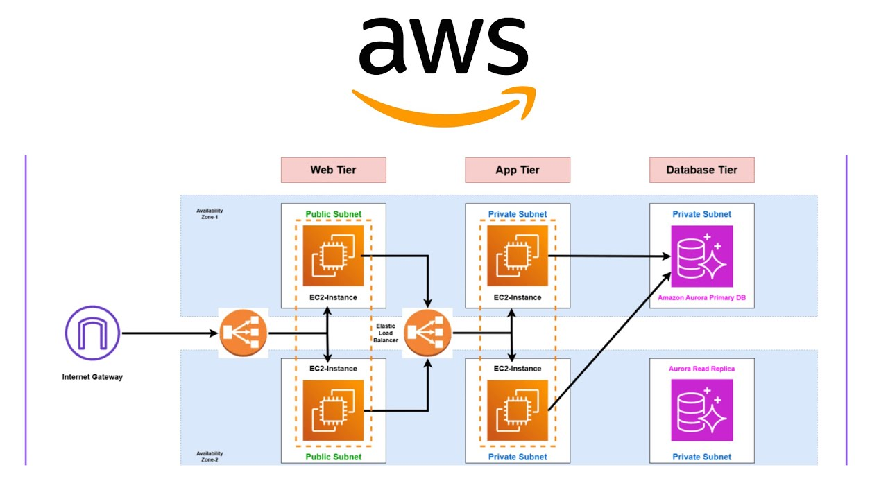
Database Tier – RDS Setup
Amazon RDS (MySQL) – Managed database
Multi-AZ for high availability
Automated backups & maintenance
Secure access with Security Groups
Stores Joomla CMS data

Slide 9
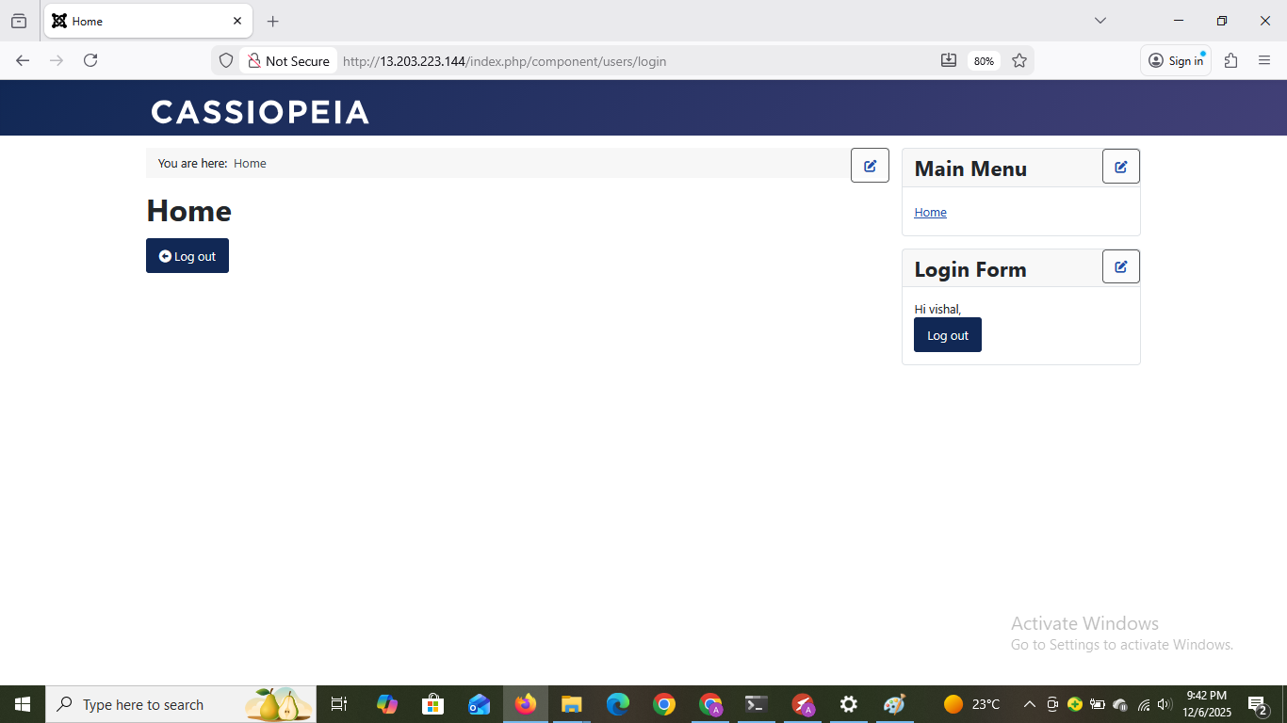
Successfully Login in Database

Slide 10
Project Learning
Gained hands-on experience deploying a two-tier web application on AWS.
Learned to configure VPC, Subnets, Route Tables, and Security Groups.
Deployed EC2 as web server and RDS as database for Joomla.
Understood networking, security, and database connectivity in cloud environments.
Learned to make applications scalable, secure, and reliable on AWS.

Slide 11
Summary
Deployed a two-tier joomla web application on AWS.
Used EC2 for the web server and RDS for the database.
Configured VPC, Subnets, Route Tables, and Security Groups for secure networking.
Learned to make the application scalable, secure, and reliable.

